Slide 1


Software Engineering

Slide 2
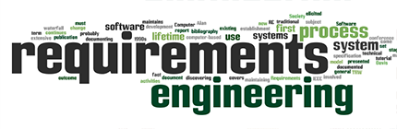

Slide 3
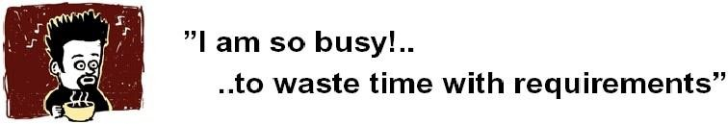
The Root Causes of Project Success and Failure
The first step in resolving any problem is to understand the root causes.
The 1994 Standish Group survey study noted the three commonly cited factors that caused projects to be
Lack of user input: 13 percent of all projects
Incomplete requirements and specifications: 12 percent of all projects
Changing requirements and specifications: 12 percent of all projects

Slide 4
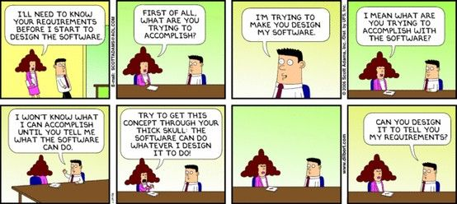
Notes:
clients expect developers to read their minds instead of providing clear project specifications.

Slide 5
Requirement
Requirements form the basis for all software products
Requirements engineering is the process, which enables us to systematically determine the requirements for a software product
Something required, something wanted or needed
Webster’s dictionary
There is a huge difference between wanted and needed and it should be kept in mind all the time
Need- something you have to have
Want -something you would like to have

Slide 6
Requirements
Requirements are ... A specification of what should be implemented. They are descriptions of how the system should behave, or of a system property or attribute. They may be a constraint on the development process of the system.
A condition or capability that must be met or possessed by a system...to satisfy a contract, standard, specification, or other formally imposed document
IEEE Std 729
Can be constraint
Functionality

Slide 7
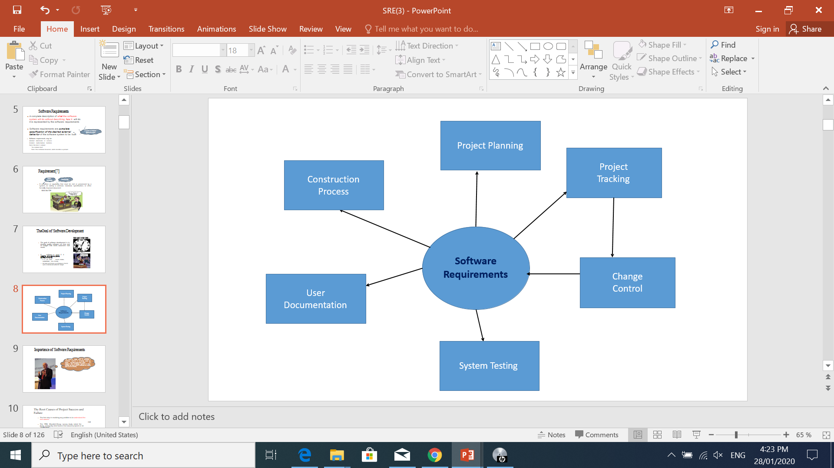
Role of Requirements

Slide 8
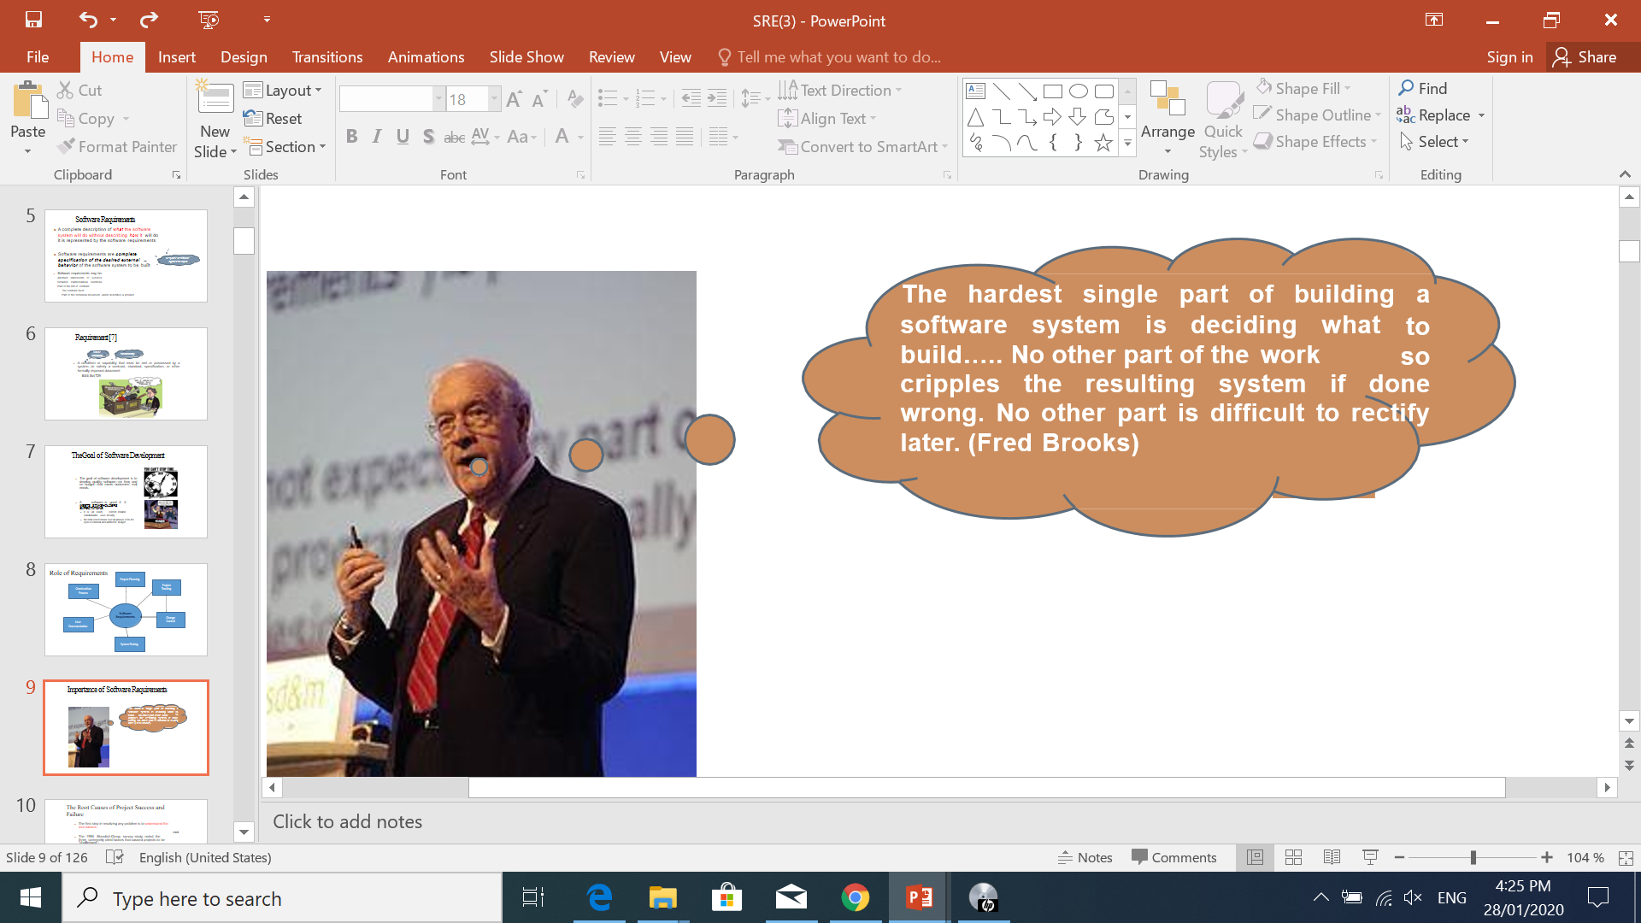
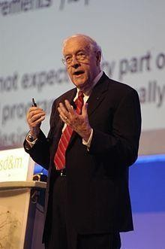

Importance of Software Requirements

Slide 9
Importance of Software Requirements
Fredrick Brooks :
“The hardest part of building a software system is deciding precisely what to build.
No other part of the conceptual work is as difficult as establishing the detailed technical requirements, including all of the interfaces to people, to machines, and to other software systems.
No other part of the work so cripples the resulting system if done wrong.
No other part is more difficult to rectify later”
Karl Wiegers
“If you don’t get the requirements right, it doesn’t matter how well you do anything else.”
One can end up doing a perfect job of building the wrong product.

Slide 10
W⁴ H of Requirements
What:
The various levels and types of requirements that need to be defined
Why:
The benefits of having the right software requirements
Who:
The stakeholders of the software requirements and getting them involved in the process
When:
Requirements activities throughout the software development life cycle
How:
Techniques for eliciting, analyzing, specifying, and validating software requirements
Notes:
Here’s an example applying the W⁴H framework to a library management system:
What → The system should allow users to borrow, return, and search for books.
Why → To improve efficiency in book management, reduce manual work, and enhance the user experience.
Who → Stakeholders include librarians, students, faculty, and IT administrators.
When → Requirement gathering happens before development, with updates during the software lifecycle.
How → Techniques like interviews, surveys, and prototyping help define, analyze, and validate the requirements.

Slide 11
A patient information system for mental health care
A patient information system to support mental health care (the Mentcare system) is a medical information system that maintains information about patients suffering from mental health problems and the treatments that they have received.
To make it easier for patients to attend, these clinics are not just run in hospitals. They may also be held in local medical practices or community centers.

Slide 12
A patient information system for mental health care
This system has two purposes:
To generate management information that allows health service managers to assess performance against local and government targets.
To provide medical staff with timely information to support the treatment of patients.

Slide 13
Key Features
The key features of the system are:
1. Individual care management Clinicians can create records for patients, edit the information in the system, view patient history, and so on. The system supports data summaries so that doctors who have not previously met a patient can quickly learn about the key problems and treatments that have been prescribed.
2. Patient monitoring The system regularly monitors the records of patients that are involved in treatment and issues warnings if possible problems are detected. Therefore, if a patient has not seen a doctor for some time, a warning may be issued. One of the most important elements of the monitoring system is to keep track of patients who have been sectioned and to ensure that the legally required checks are carried out at the right time.

Slide 14
Key Features
Administrative reporting The system generates monthly management reports showing the number of patients treated at each clinic, the number of patients who have entered and left the care system, the number of patients sectioned, the drugs prescribed and their costs, etc.

Slide 15
Requirements Classification
User Requirements
System Requirements

Slide 16
User Requirements
User requirements are statements, in a natural language plus diagrams (conceptual models), of what services the system is expected to provide to system users and the constraints under which it must operate. The user requirements may vary from broad statements of the system features required to detailed, precise descriptions of the system functionality.
System requirements are more detailed descriptions of the software system’s functions, services, and operational constraints. The system requirements document (sometimes called a functional specification) should define exactly what is to be implemented. It may be part of the contract between the system buyer and the software developers.
Notes:
User requirements describe what the user needs. 🔹 System requirements explain how the system will meet those needs.

Slide 17
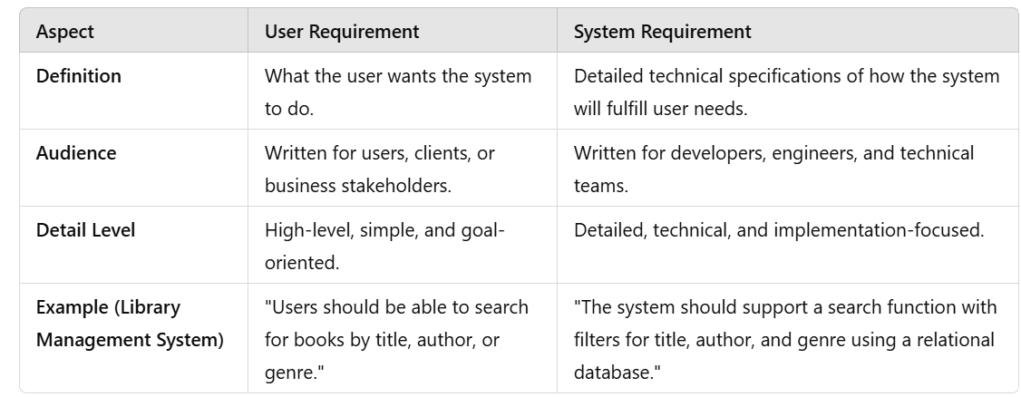

Slide 18
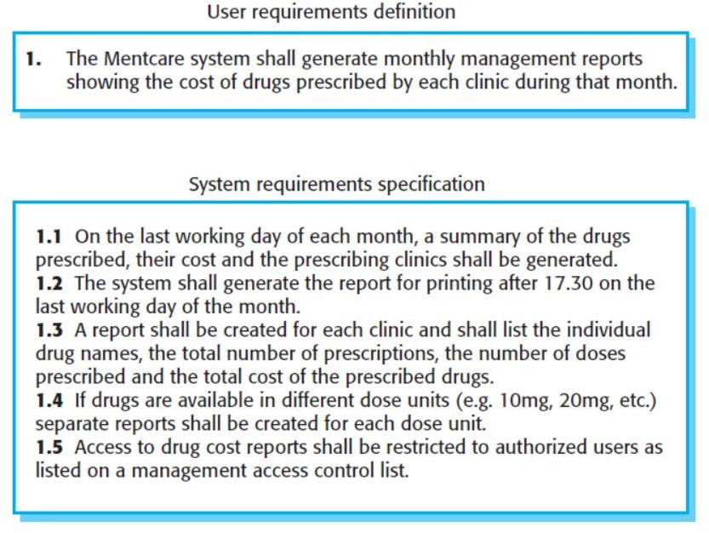
Mental health care patient information system (Mentcare)

Slide 19
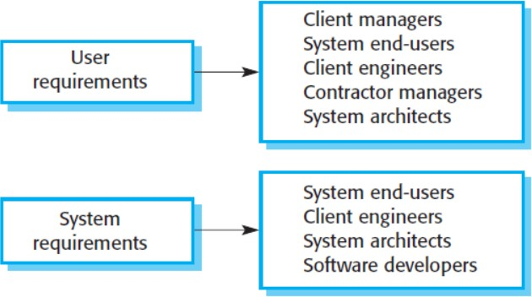
Requirements
You need to write requirements at different levels of detail because different types of readers use them in different ways.
The readers of the user requirements are not usually concerned with how the system will be implemented and may be managers who are not interested in the detailed facilities of the system.
The readers of the system requirements need to know more precisely what the system will do because they are concerned with how it will support the business processes or because they are involved in the system implementation.
In figure there are examples of system stakeholders. Many stakeholders like end-user, manager,

Slide 20
System stakeholders for the Mentcare system
Mental health care patient information system (Mentcare)
Patients whose information is recorded in the system and relatives of these patients.
Doctors who are responsible for assessing and treating patients.
Nurses who coordinate the consultations with doctors and administer some treatments.
Medical receptionists who manage patients’ appointments.
IT staff who are responsible for installing and maintaining the system.
A medical ethics manager who must ensure that the system meets current ethical guidelines for patient care.
Health care managers who obtain management information from the system.
Medical records staff who are responsible for ensuring that system information can be maintained and preserved, and that record keeping procedures have been properly implemented.
Notes:
Stakeholder refers to, “a person, group or company that is directly or indirectly involved in the project and who may affect or get affected by the outcome of the project”.

Slide 21
Activity
Question 1. Identify possible stakeholders in the following systems:
(1) A stockholding system for oil companies which keeps track of the amount of petrol (gas) at each of its sales outlets and automatically reorders new stock
(2) A train protection system which will automatically bring a train to a halt if it exceeds the speed limit for a track segment or if it goes through a red signal. when the tanks fall below a certain level.

Slide 22
Activity
(1) A stockholding system for oil companies which keeps track of the amount of petrol (gas) at each of its sales outlets and automatically reorders new stock when the tanks fall below a certain level.
Response: Possible stakeholders are fuel delivery drivers, service station owners, service station sales staff, fuel supply operators, oil company management, oil company accountants, oil company buyers
(2) A train protection system which will automatically bring a train to a halt if it exceeds the speed limit for a track segment or if it goes through a red signal.
Response: Possible stakeholders train passengers, train driver, signallers, train operating company management, railway safety authorities, training staff

Slide 23
Levels of Requirements
Business Requirements
User Requirements
Functional Requirements
Non-Functional Requirements
Notes:
Business → Why?
User → What?
Functional → How?
Non-Functional → How well?

Slide 24
Business Requirements
WHY the Software Product is being developed”- Stated as “OBJECTIVES”.
These are used to state the high-level business objective of the organization or customer requesting the system or product
They are used to document main system features and functionalities without going into their nitty-gritty details
They are captured in a document describing the project vision and scope

Slide 25
Business Requirements
For example, a web application is designed and developed to offer better parcel delivery services to customers.
What is the business requirement ?
Offer a smarter solution to measure, select, and ship parcels
Provide capabilities to track and manage their delivery and pick-up services
On-time delivery and customer feedback

Slide 26
User Requirements
User requirements add further detail to the requirements
User requirements are statements of what services the system is expected to provide to system users and the constraints under which it must operate.

Slide 27
Functional Requirements
These are statements of services the system should provide, how the system should react to particular inputs, and how the system should behave in particular situations
Depend on the type of software being developed
When expressed as user requirements, functional requirements should be written in natural language so that system users and managers can understand them.
Functional system requirements expand the user requirements and are written for system developers. They should describe the system functions, their inputs and outputs, and exceptions in detail.
In some cases, the functional requirements may also explicitly state what the system should not do

Slide 28
Mentcare (Example)
A user shall be able to search the appointments lists for all clinics.
The system shall generate each day, for each clinic, a list of patients who are expected to attend appointments that day.
Each staff member using the system shall be uniquely identified by his or her eight-digit employee number.

Slide 29
Non-Functional Requirements
These are constraints on the services or functions offered by the system
They include timing constraints, constraints on the development process, and constraints imposed by standards
Non-functional requirements often apply to the system as a whole, rather than individual system features or services
For example, to ensure that performance requirements are met in an embedded system, you may have to organize the system to minimize communications between components.

Slide 30
Non-Functional Requirements
Non-Functional
requirements
Product requirements
Organizational requirements
External requirements

Slide 31
Product Requirements
Efficient in speed of execution
After completion how much
time require to understand fully.
User supportive.
Available 24 hours.
No crash single time
Product
requirements
Usability requirements
Efficiency requirements
Reliability requirements
Portability requirements
Run on multiple platform(ma os, window, …)
Performance
requirements
Space
requirements
Notes:
PRODUCT REQUIREMENT The MHC-PMS shall be available to all clinics during normal working hours (Mon–Fri, 08.30–17.30). Downtime within normal working hours shall not exceed five seconds in any one day.

Slide 32
Product Requirements
Reliability and performance
The system shall allow one hundred thousand hits per minute on the website
The system shall not have down time of more than one second for continuous execution of one thousand hours
Mean time to failure

Slide 33
Organizational Requirements
Organizational
requirements
Standards requirements
Implementation requirements
Delivery requirements
Notes:
ORGANIZATIONAL REQUIREMENT Users of the MHC-PMS system shall authenticate themselves using their health authority identity card.

Slide 34
External Requirements
Relationship with other organizations.
External requirements
Interoperability requirements
Ethical requirements
Legislative requirements
Privacy
requirements
Safety
requirements
Notes:
EXTERNAL REQUIREMENT The system shall implement patient privacy provisions as set out in HStan-03-2006-priv

Slide 35
External Requirements
Multiple organization are going to use your same product.
Therefore software companies does not give code and documentation
External requirements
Interoperability requirements
Ethical requirements
Legislative requirements
Privacy
requirements
Safety
requirements

Slide 36
External Requirements
External requirements
Should handle by developer
Critical issues
Maintainability issues
Recovery Issues
Interoperability requirements
Ethical requirements
Legislative requirements
Privacy
requirements
Safety
requirements

Slide 37
External Requirements
The system shall not disclose any personal information about members of the library system to other members except system administrators
The system shall comply with the local and national laws regarding the use of software tools

Slide 38
Domain Requirements
Requirements that come from the application domain and reflect fundamental characteristics of that application domain
Can be functional or non-functional
These requirements, sometimes, are not explicitly mentioned, as domain experts find it difficult to convey them. However, their absence can cause significant dissatisfaction
Notes:
The system safety shall be assured according to standard IEC 60601-1:Medical Electrical Equipment – Part 1:General Requirements for Basic Safety and Essential Performance.
The system safety shall be assured according to standard IEC 60601-1:Medical Electrical Equipment – Part 1:General Requirements for Basic Safety and Essential Performance.

Slide 39
Domain Requirements
Domain requirements can impose strict constraints on solutions
This is particularly true for scientific and engineering domains
Domain-specific terminology can also cause confusion
Media player

Slide 40
Inverse Requirements
They explain what the system shall not do.
Many people find it convenient to describe their needs in this manner
These requirements indicate the indecisive nature of customers about certain aspects of a new software product

Slide 41
Design and Implementation Constraints
They are development guidelines within which the designer must work, which can seriously limit design and implementation options
Can also have impact on human resources

Slide 42
Relationship of Several components of Software Requirements
Business
Requirements
Vision and
Scope document
User
Requirements
Quality
Attributes
Other
Non-functional
Requirements
Use Case document
Constraints
System
Requirements
Functional
Requirements
Functional Specification Documents

Slide 43
Some Risks From Inadequate Requirement Process
Insufficient user involvement leads to unacceptable products
Creeping user requirements contribute to overruns and degrade product quality
Ambiguous requirements lead to ill-spent time and rework
Gold-plating by developers and users adds unnecessary features

Slide 44
Some Risks From Inadequate Requirement Process
Minimal specifications lead to missing key requirements
Overlooking the needs of certain stake holders leads to dissatisfied customers
Incompletely defined requirements make accurate project planning and tracking impossible

